Slide 1
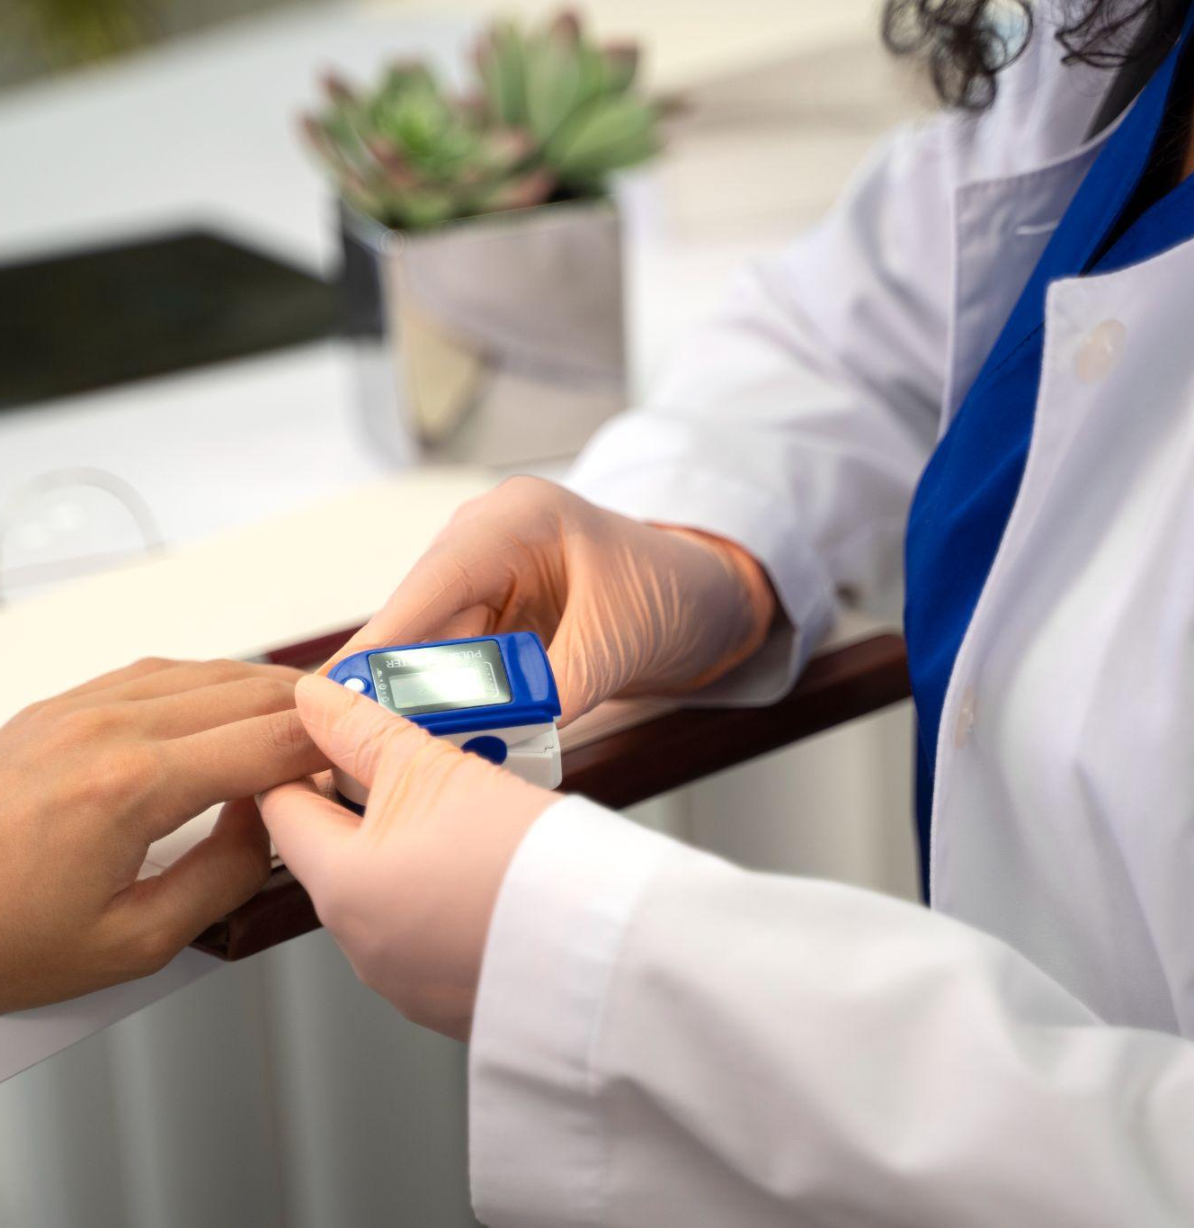
Diabetes Risk Prediction Using Logistic Regression
Team name: Insights Detectors
Team members: Anil vallepu
Naga sasitha polavarapu
Nikhitha pamidi
Project supervisor,
Dr. Kirshtein, Arkadz

Slide 2
Agenda
Diabetes disease
Objective of the project
Dataset information
List of the tools used in proposed project
Data Analysis
Data visualization
Logistic model and mathematics behind logistic model
How this diabetes problem is suitable for Logistic model
Training and Testing the model
Live demo of the model
Advantages of the proposed model
Reference papers & Conclusion

Slide 3

What is diabetes!
Any comments on diabetes disease! and based on which input parameter we can conclude the diabetes??

Slide 4
Objective of the project
The main objective the project is to provide the logistic machine learning model which as the capability to test whether the patient has diabetes or not baes on input parameters such as Glucose levels in blood , BMI, Age, DiabetesPedigreeFunction (genetic family history), then we compared logistic model accuracy with other ML models such as Decision tree, random forest, XG-boost and KNN model.

Slide 5
Dataset information
Dataset name: Diabetics Prediction dataset
Dataset volume: 768 rows × 9 columns
Training data volume: 80%
Testing data volume: 20%
Data source: Kaggle.com
Description of the input parameters:
Glucose: High glucose levels are closely associated with diabetes.
BMI: A higher BMI is often linked to diabetes risk.
Age: Older age can be associated with a higher risk of diabetes.
DiabetesPedigreeFunction: This represents genetic predisposition based on family history.

Slide 6
List of the tools used in proposed project
01
02
03
04
05
Python
Python for DS
Scikit-learn
Used to write the business logic
Used Numpy, Pandas and Matplotlib for data analysis
Used to import required ML algorithm
Machine Learning
Jupyter notebook IDE
Used Logistic regression model to classify the diabetes dataset & Compared with other ML model performance
Used to compile the proposed model

Slide 7
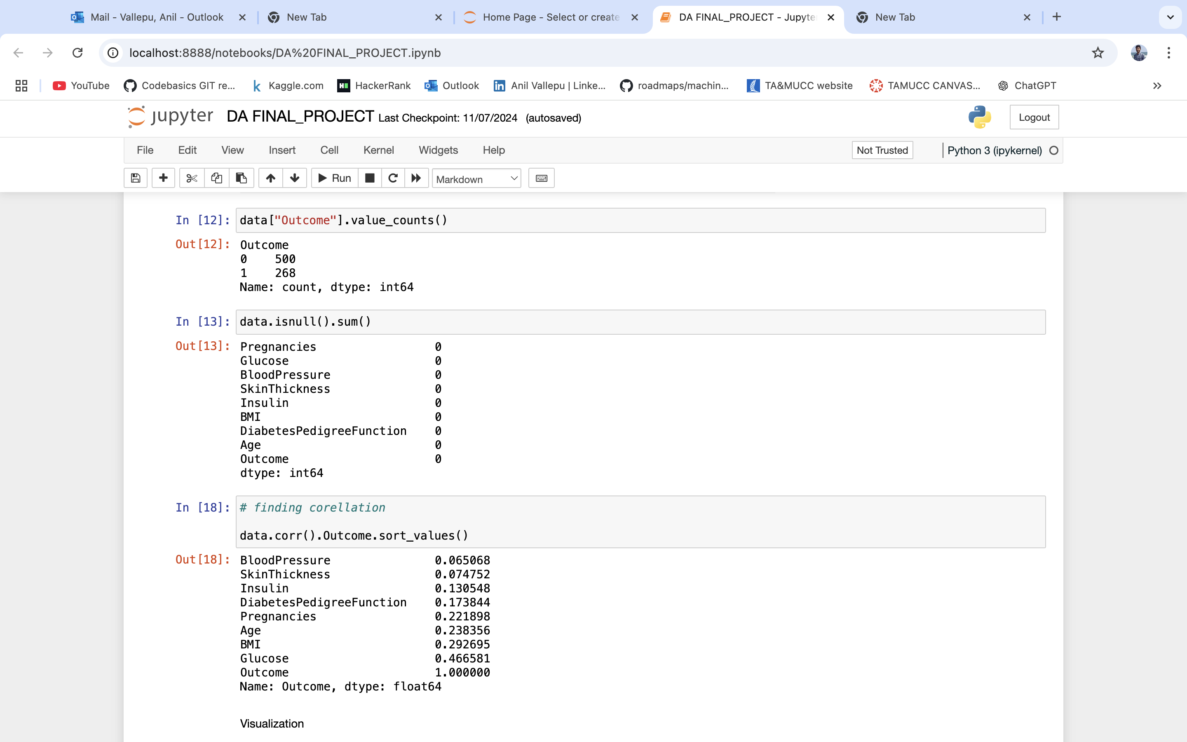
Exploratory data analysis (EDA)
Here we have cleaned the whole dataset
Isnull()
Fillna()
Data.correlation()
Correlation matrix
EDA

Slide 8
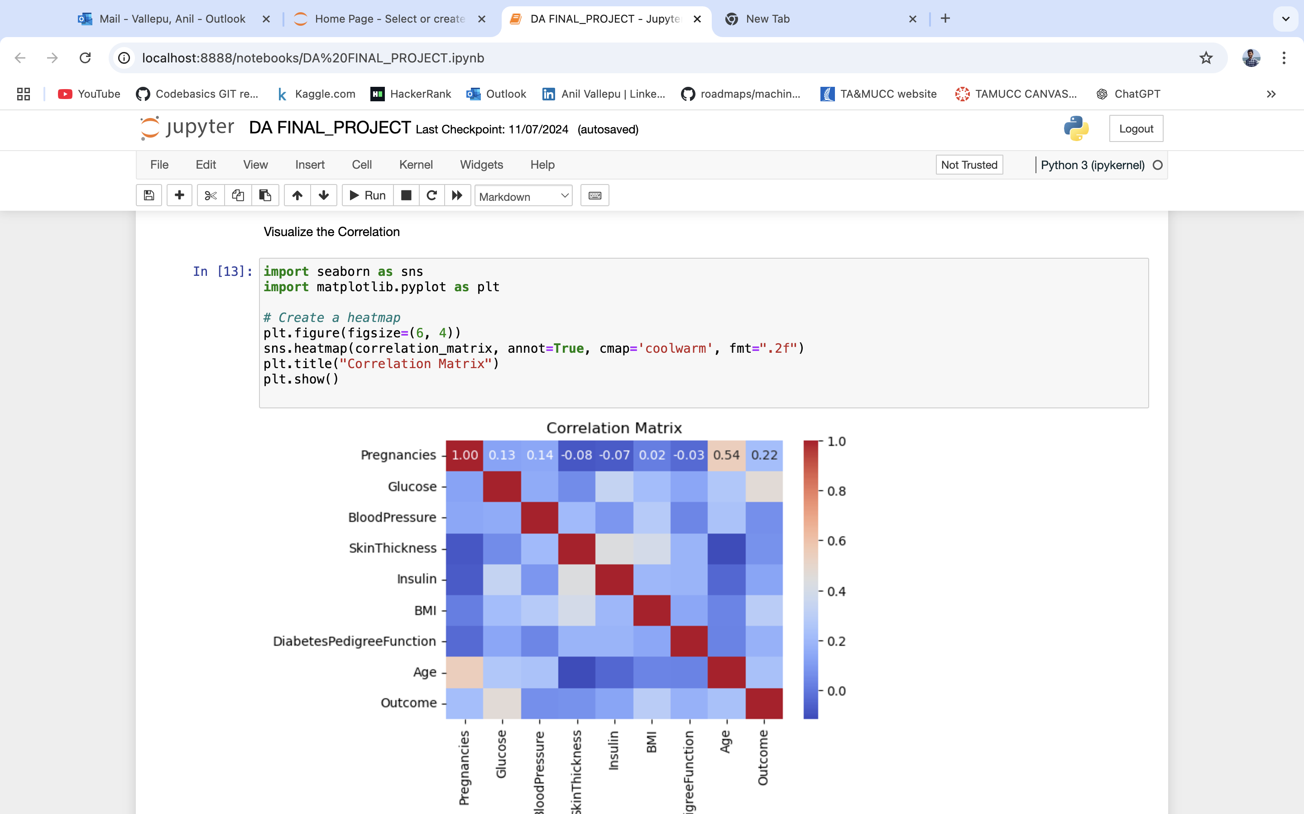
Correlation matrix
.

Slide 9
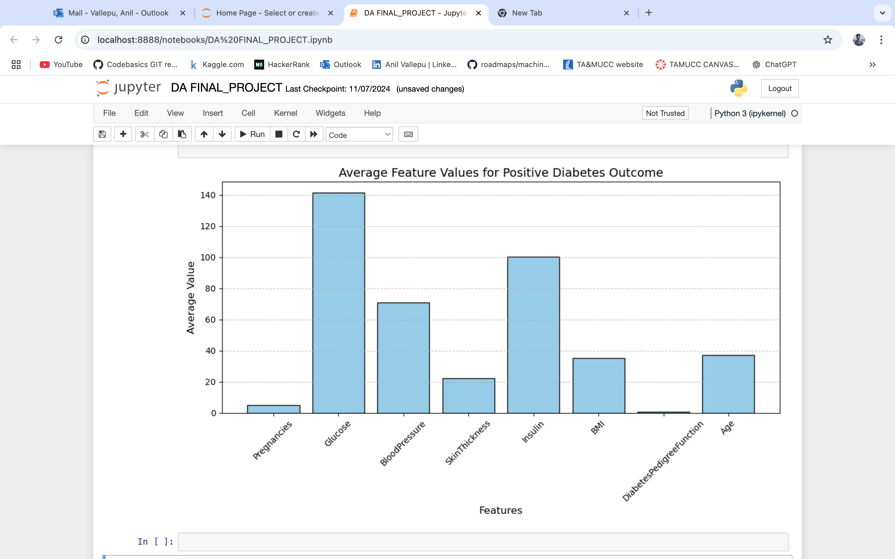
Data visualization

Slide 10
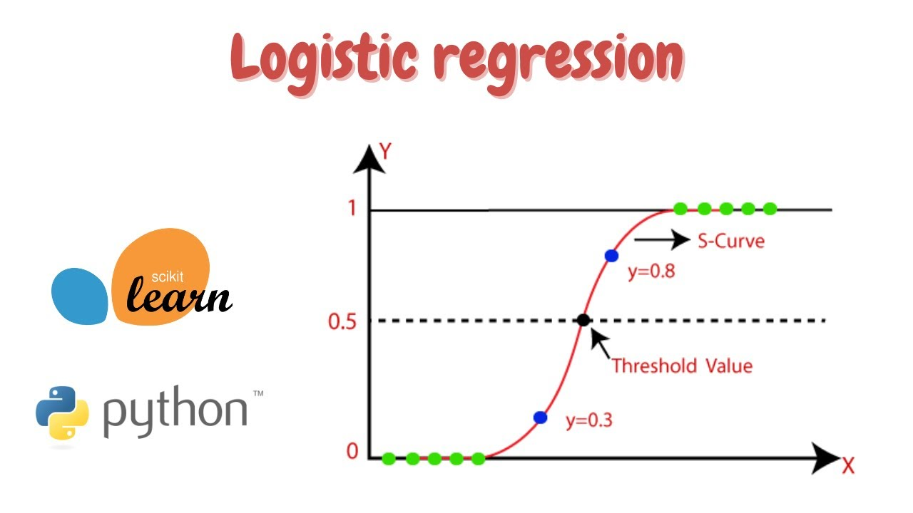
Logistic Regression &Math behind logistic model
Logistic Regression is a statistical
and machine learning model used
for classification problems. Unlike
linear regression, which predicts a
continuous outcome, logistic
regression predicts the probability
of an event occurring and maps
these probabilities to one of the
discrete classes (e.g., 0 or 1, True
or False).
Formula: sigma(z) = 1/1+e^{-x}

Slide 11
How diabetes problem is suitable for logistic model
A diabetes classification problem is suitable for a logistic regression model because it typically involves binary classification, where the goal is to determine whether a person has diabetes or not (e.g., diabetic vs. non-diabetic)
Binary Outcome(+ve or –ve)
Logistic regression is designed to handle a categorical dependent variable:
Dependent variable: Whether a person has diabetes (0 for no, 1 for yes).
For instance:
If a classification output of 1 means "diabetic"
If a classification output of 0 means "non-diabetic"

Slide 12
Threshold value for Classification
The model applies a decision threshold to convert the probability into a binary class
Default threshold value (0.5):
If P(y=1)≥0.5, classify as 1 (diabetic)
If P(y=1)<0.5, classify as 0 (non-diabetic)
Custom Thresholds: The threshold can be adjusted depending on the problem. For example:
In a healthcare scenario, it may be better to use a lower threshold (e.g., 0.3) to minimize false negatives (i.e., missing diabetic patients).

Slide 13
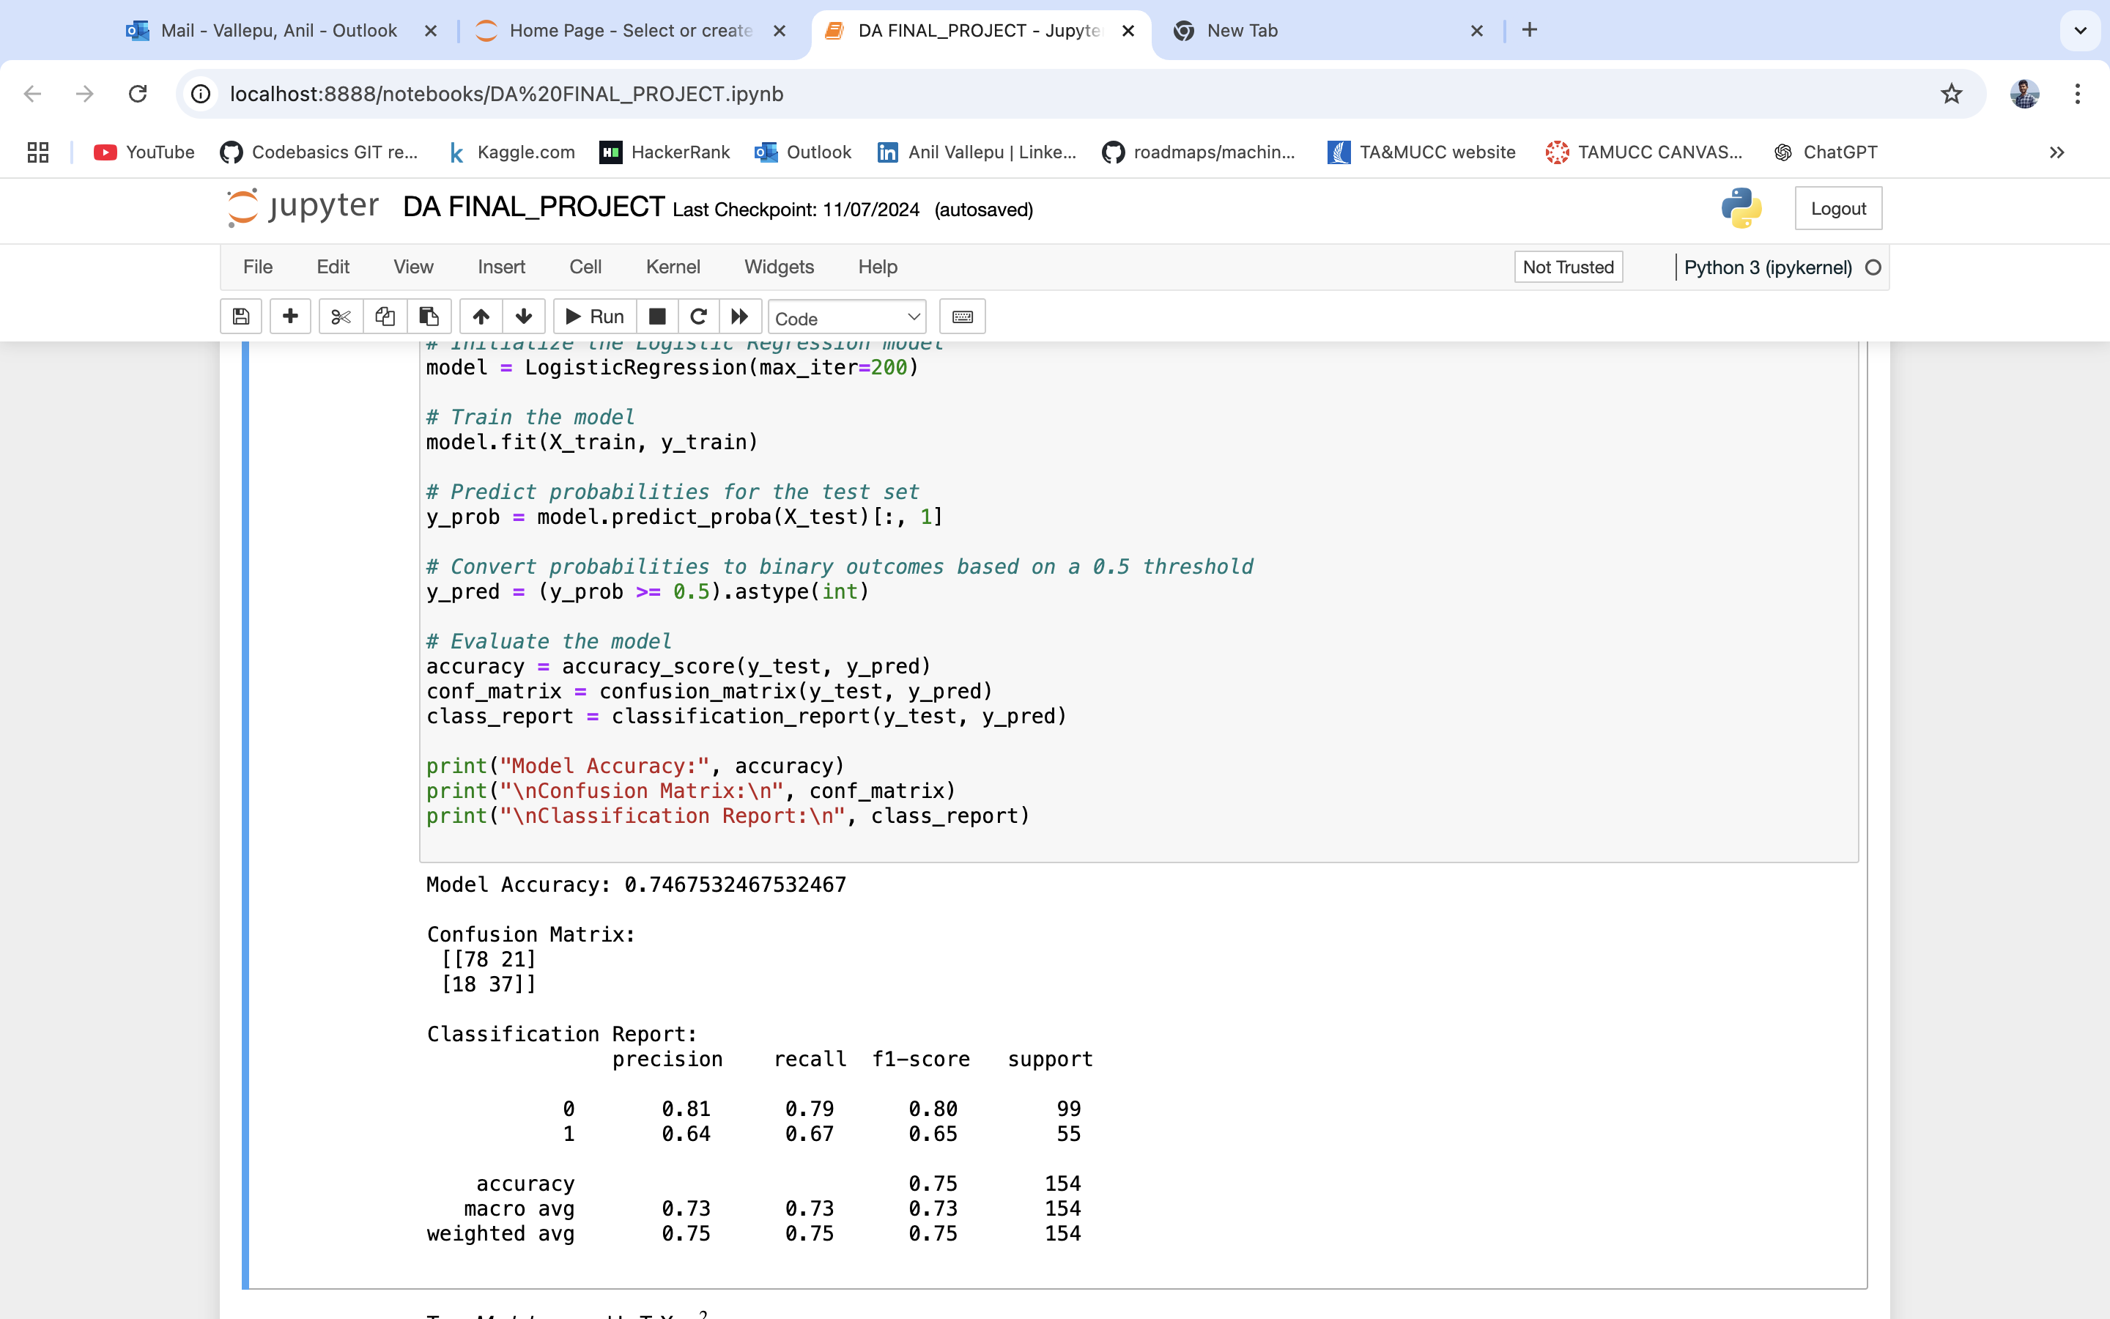
Training, Testing & Accuracy
.

Slide 14
Accuracy Comparison
.
ML Model | Accuracy
Logistic model | 0.74
Decision tree model | 0.74
Random forest model | 0.71
KNN model | 0.66
XG – Boost model | 0.70

Slide 15
Reference papers
We have conducted literature review on these two research papers:
Joshi, T., Pramila, M., Chawan, P.: Diabetes Prediction Using Machine Learning Techniques, pp. 2248– (2018). https://www.researchgate.net/publication/337275136_Diabetes_Prediction_Using_Machine _Learning_Techniques
Diabetes Prediction Using Logistic Regression and K-Nearest Neighbor https://link.springer.com/chapter/10.1007/978-981-16-9113-3_30

Slide 16
Thank you!
Do you have any questions?

